Slide 1
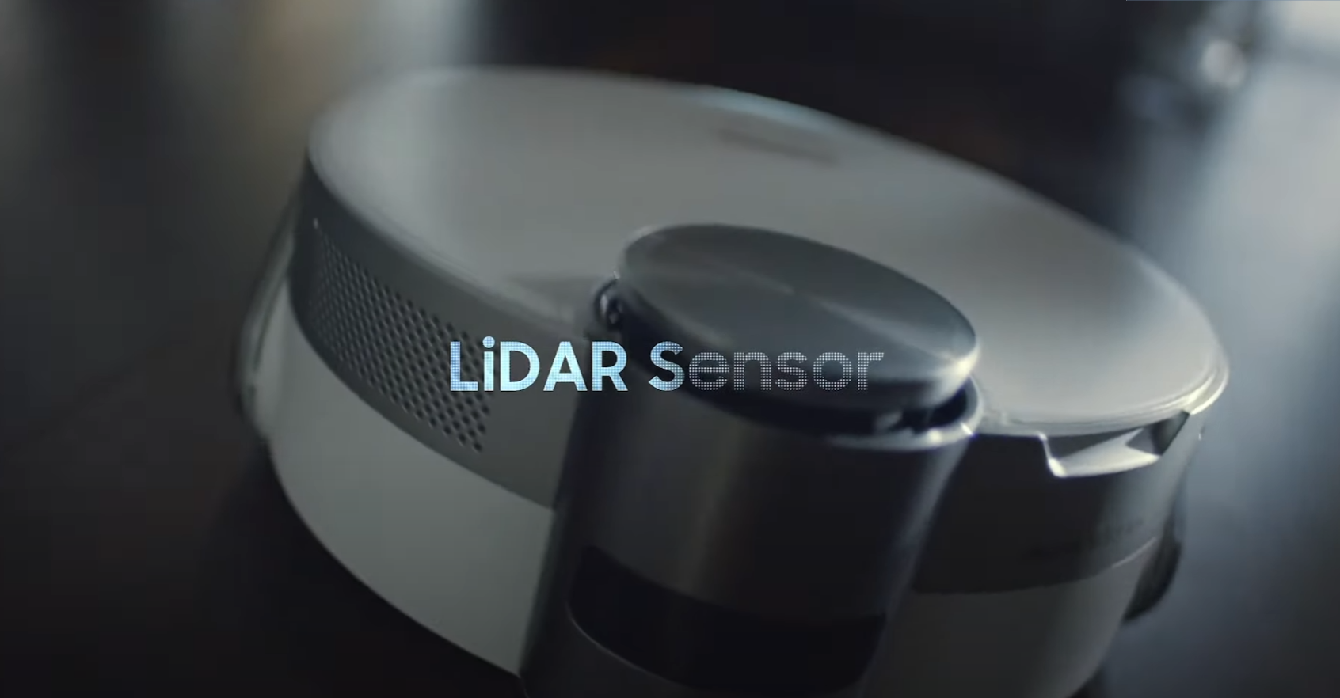

Slide 2
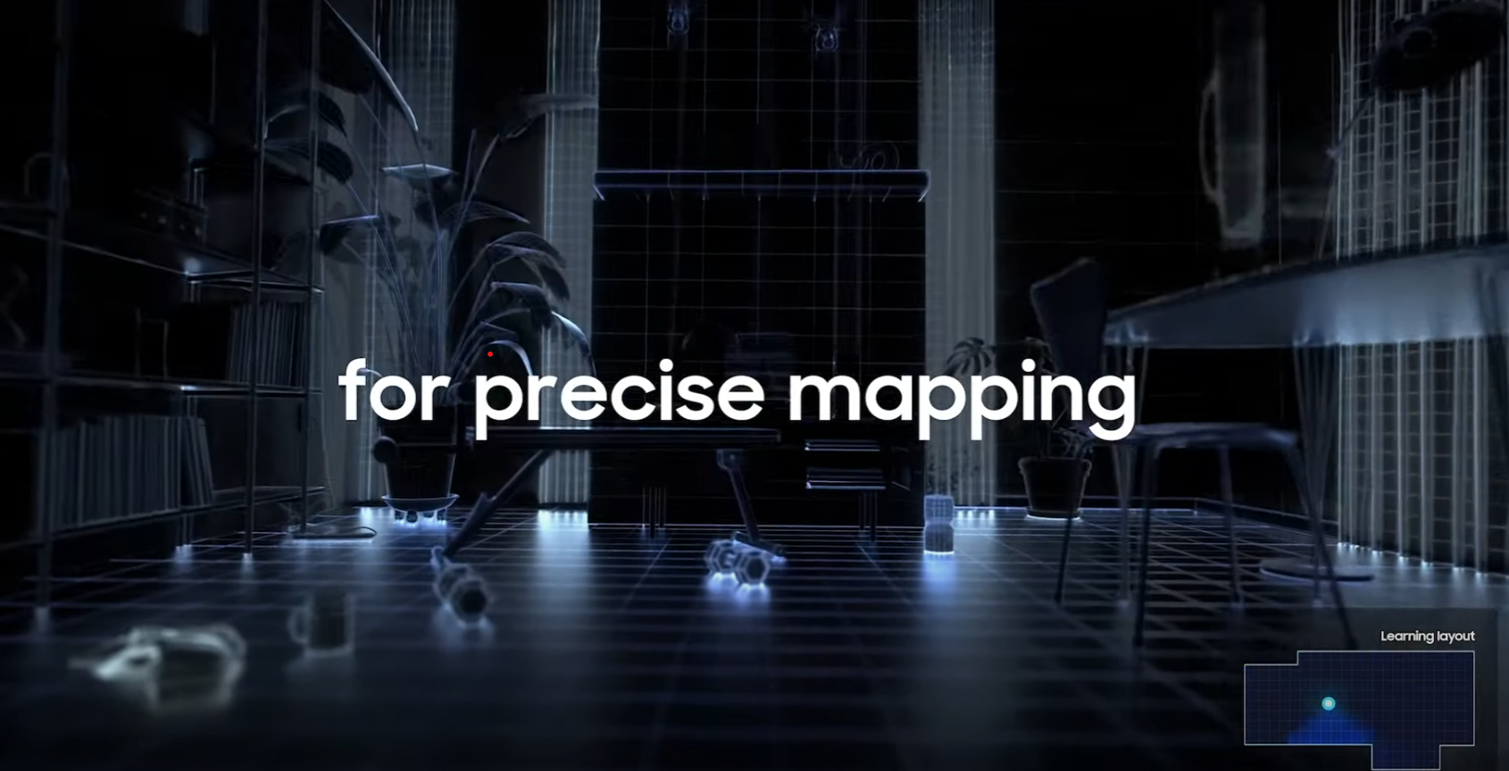

Slide 3
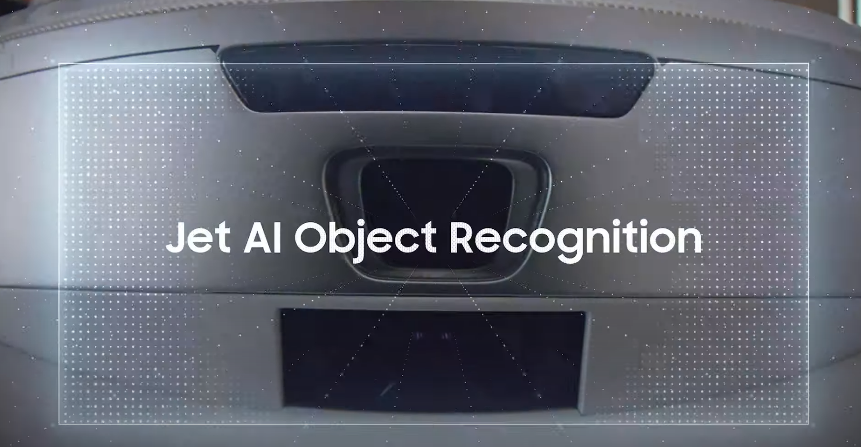

Slide 4
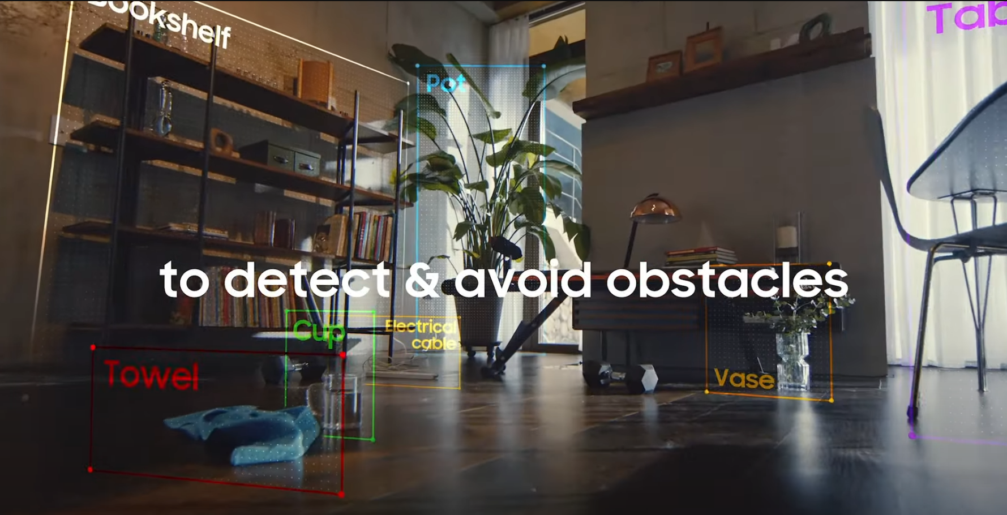

Slide 5
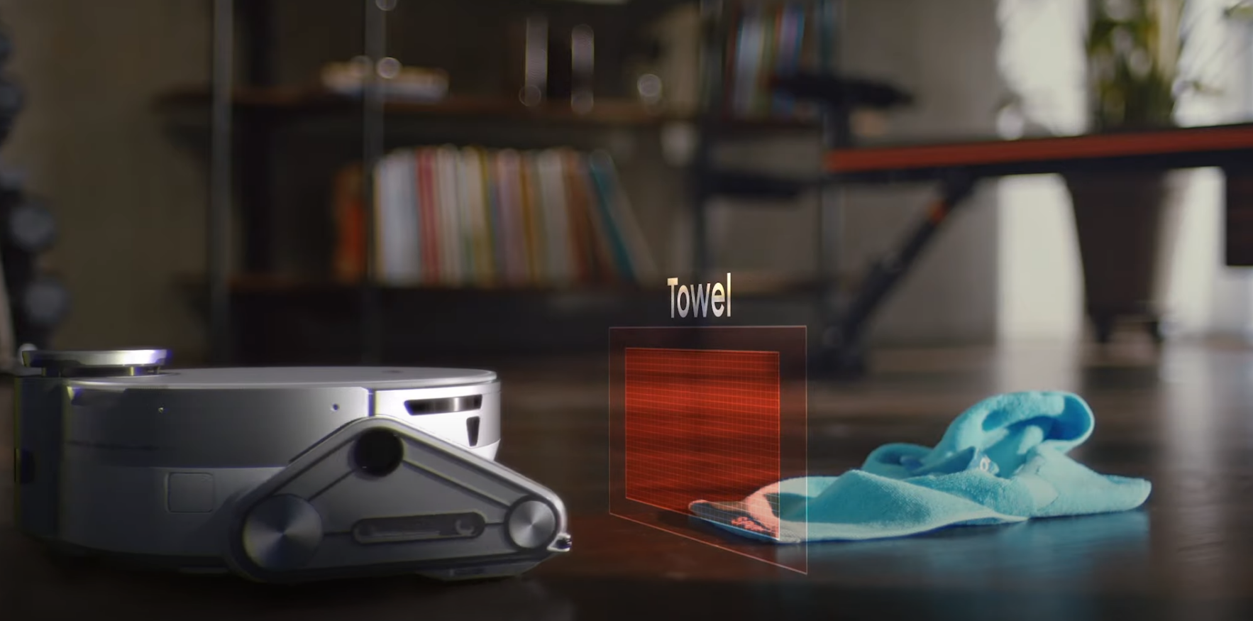

Slide 6
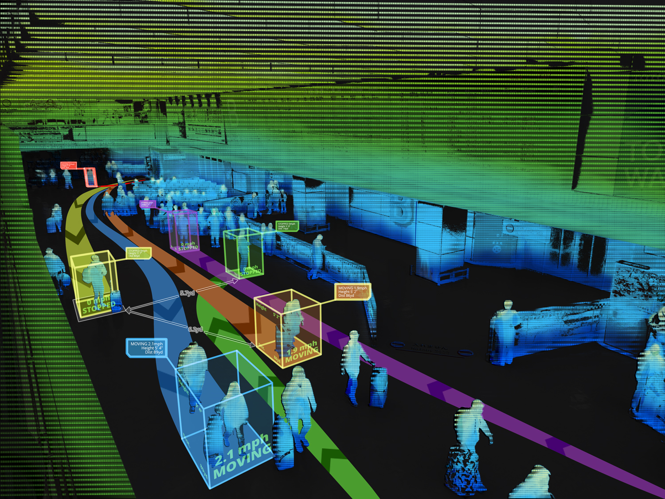
3D Mapping using Lidar
3D Mapping using Lidar (ijert.org)

Slide 7
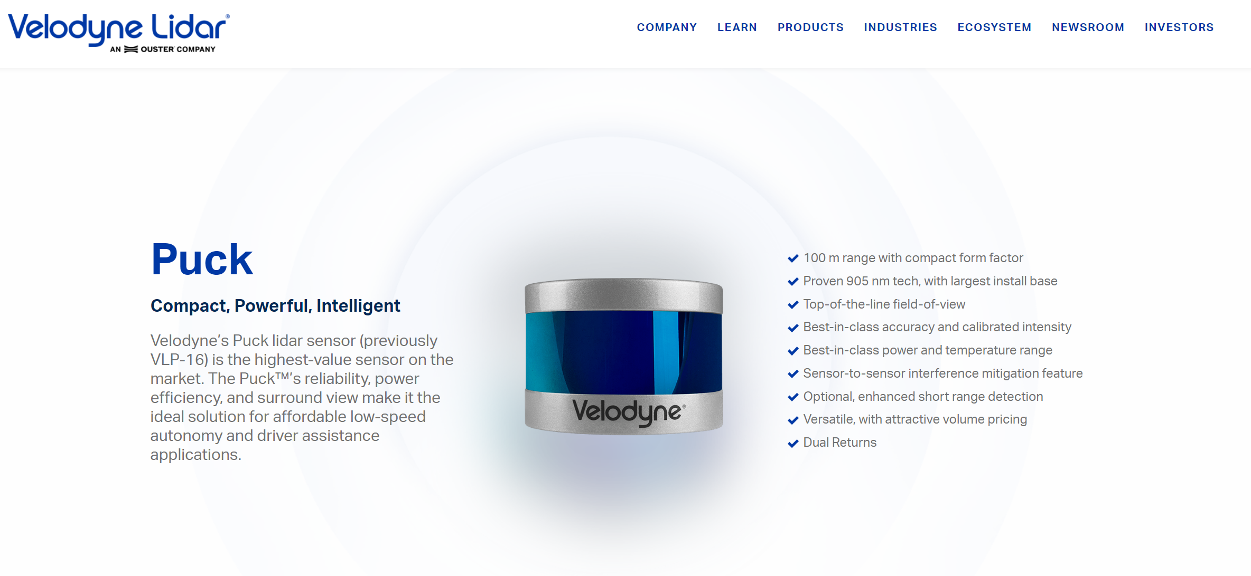

Slide 8
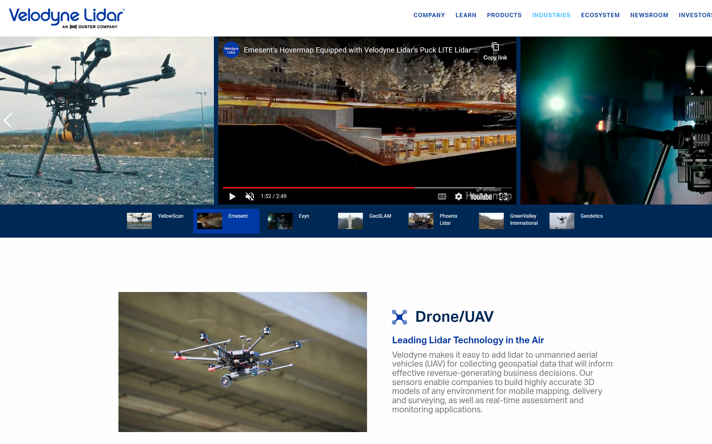

Slide 9
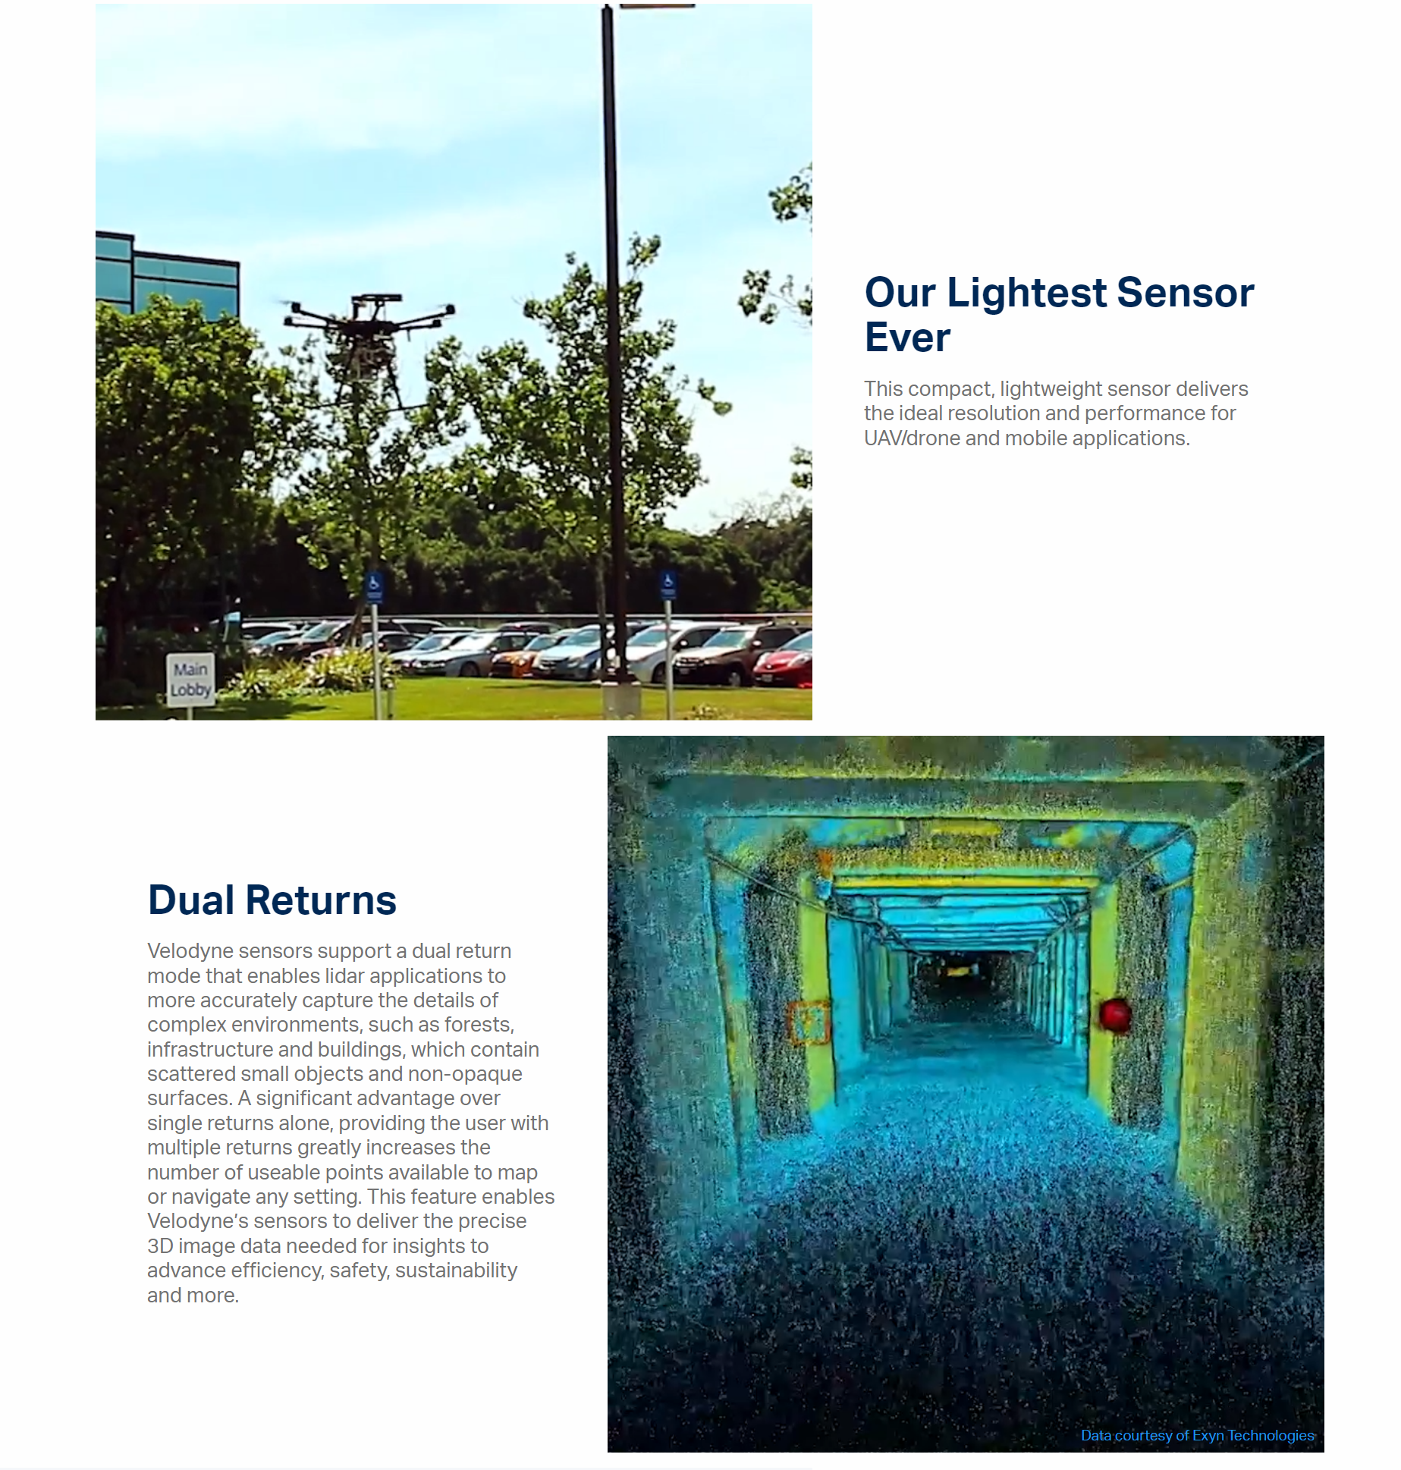
Puck LITE Lightweight Surround Lidar Sensor | Velodyne Lidar

Slide 10
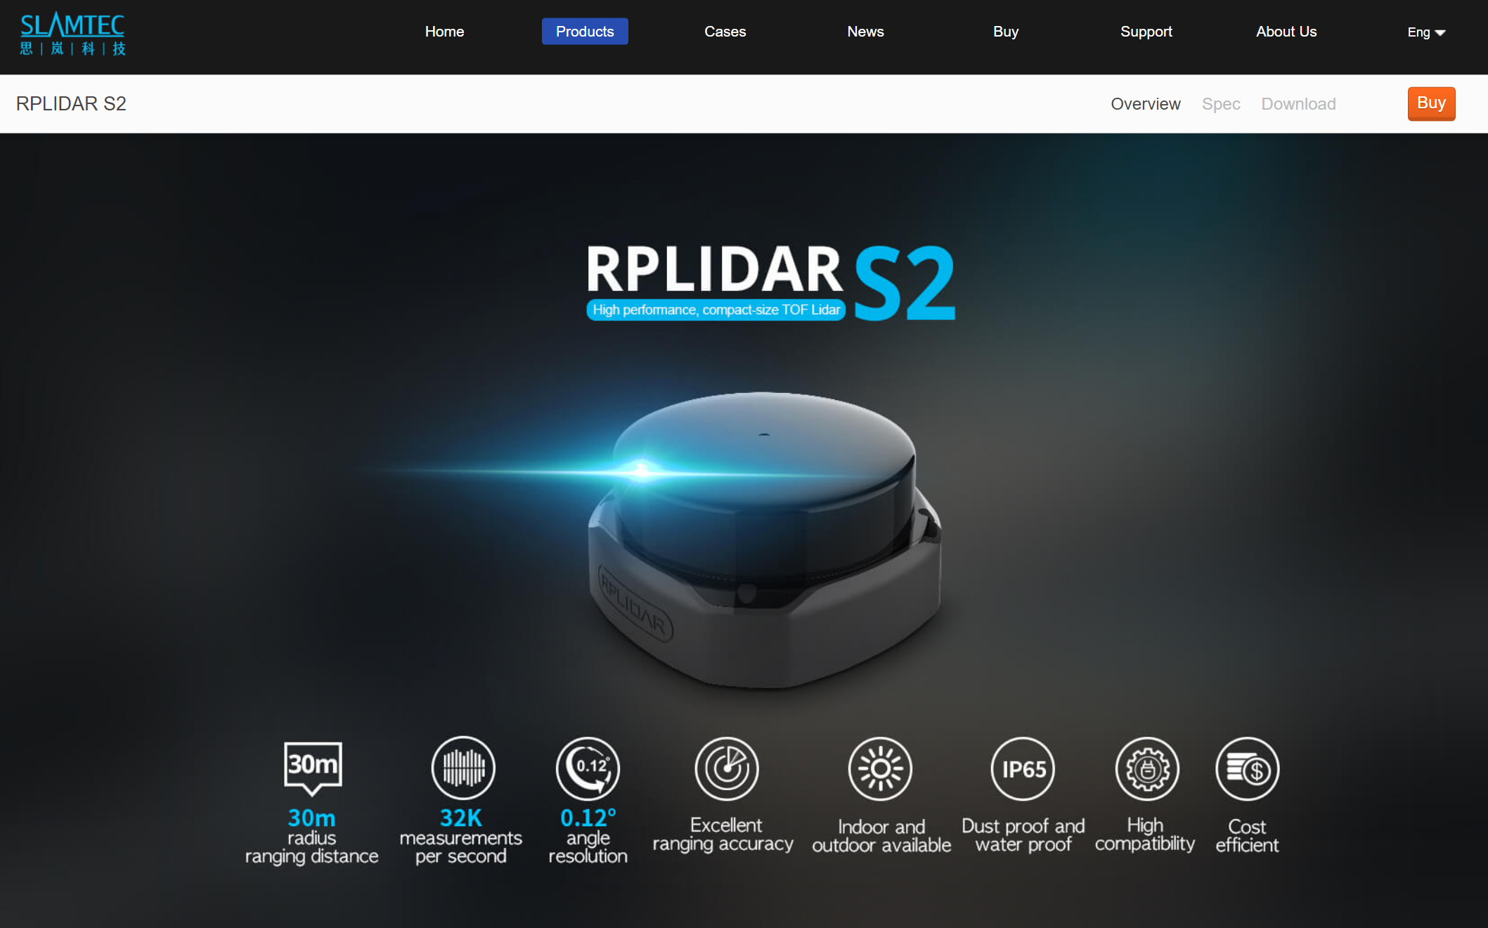
RPLIDAR S2 High performance DTOF Lidar_Workable in both Indoor and Outdoor|思岚科技（SLAMTEC）
Slamtec RPLidar S2: Costs around 45k to 50k rupees

Slide 11
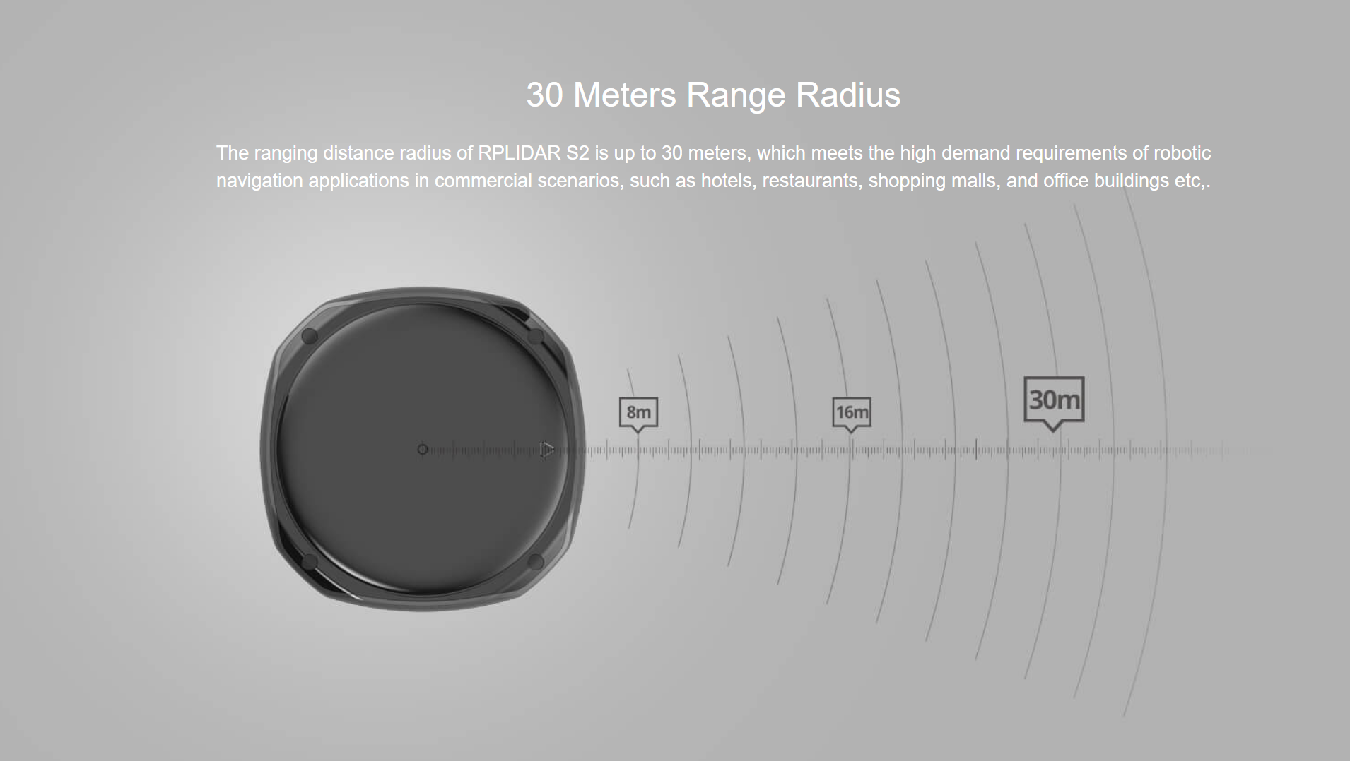

Slide 12
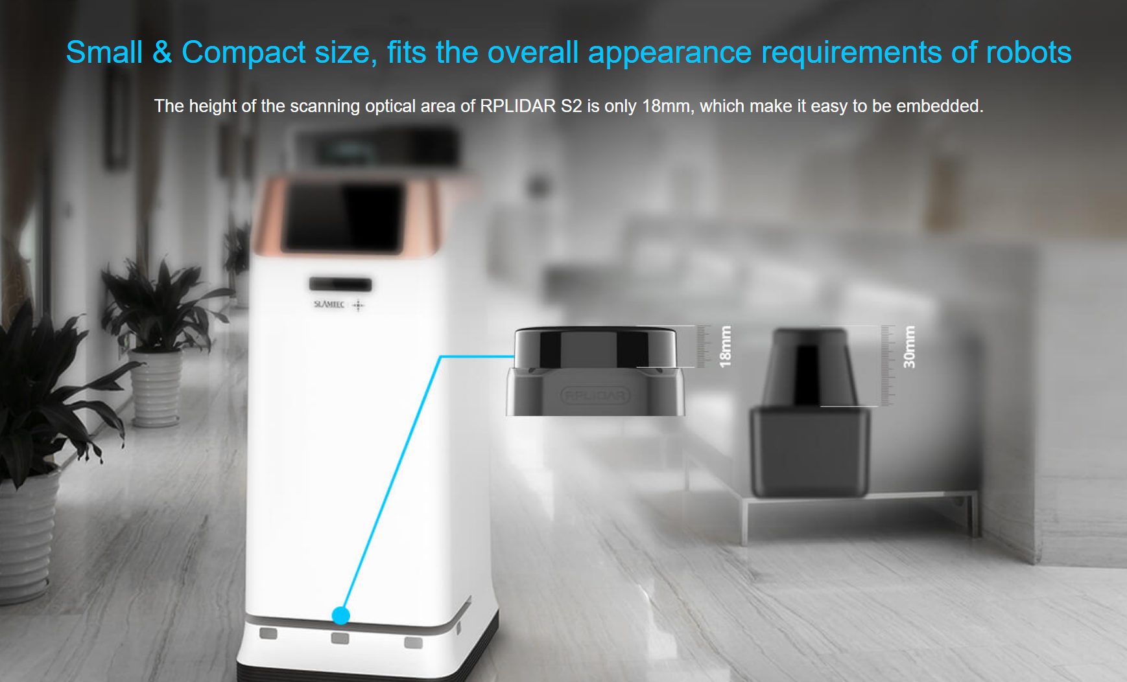
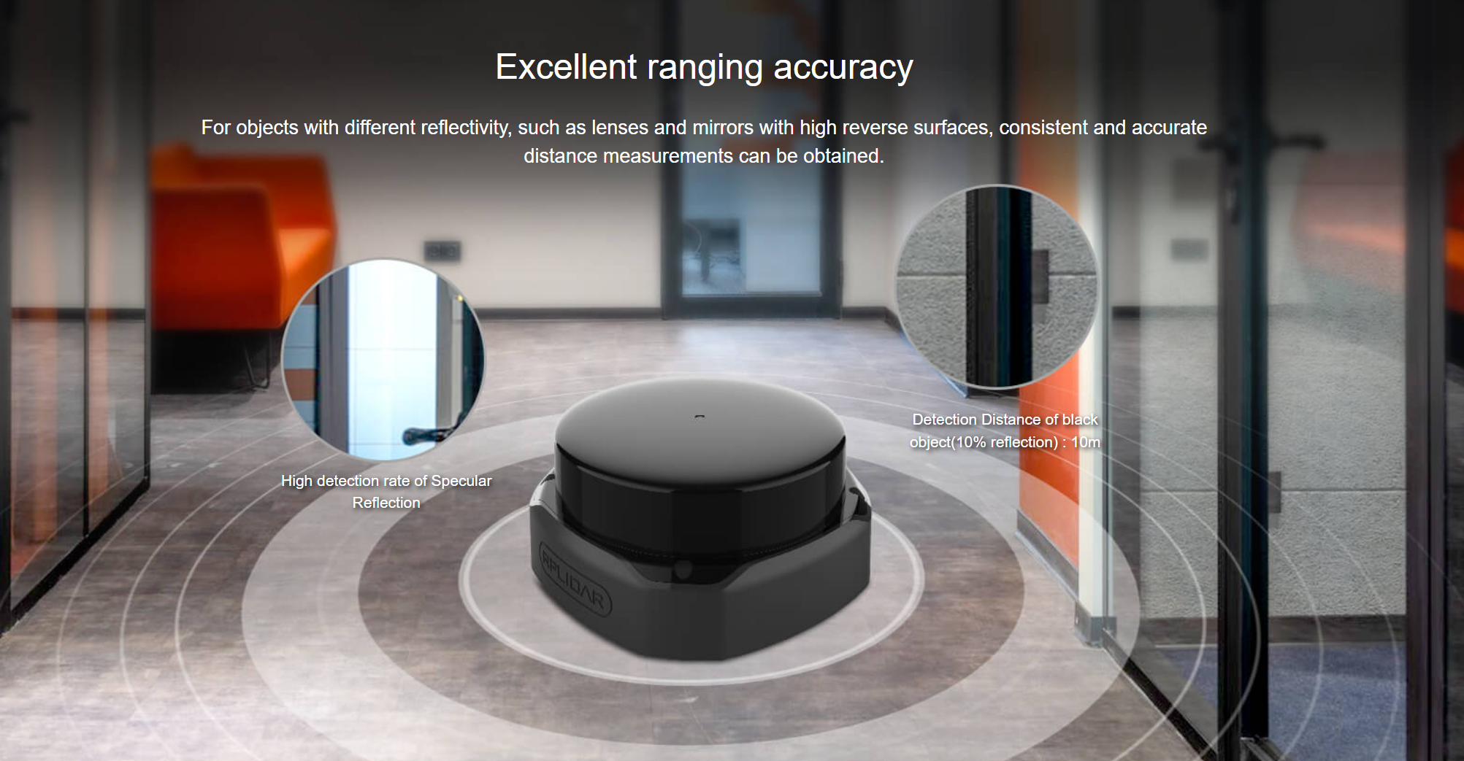

Slide 13
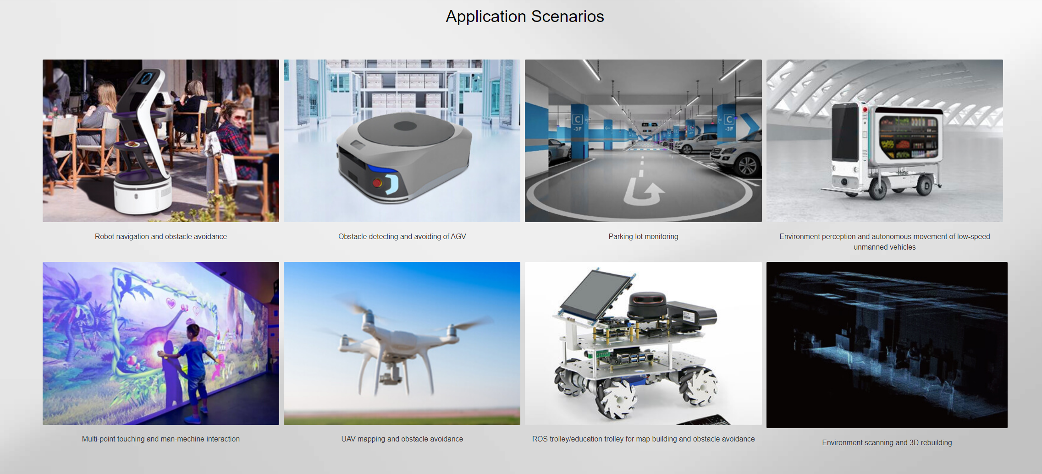

Slide 14
1. RPLidar A1M8: This is a 360-degree laser scanner that can provide a maximum range of 12 meters and has a scanning frequency of up to 5.5 Hz. It is available for around 10,000-15,000 rupees.
2. Slamtec RPLidar A1: This is a 360-degree laser scanner that can provide a maximum range of 12 meters and has a scanning frequency of up to 5.5 Hz. It is available for around 15,000-20,000 rupees.
3. Benewake TFmini-S: This is a single-point micro ranging module that can provide a range of up to 12 meters and has a scanning frequency of up to 1000 Hz. It is available for around 5,000-7,000 rupees.
4. YDLIDAR X4: This is a 360-degree laser scanner that can provide a maximum range of 10 meters and has a scanning frequency of up to 7.2 Hz. It is available for around 15,000-20,000 rupees.

Slide 15
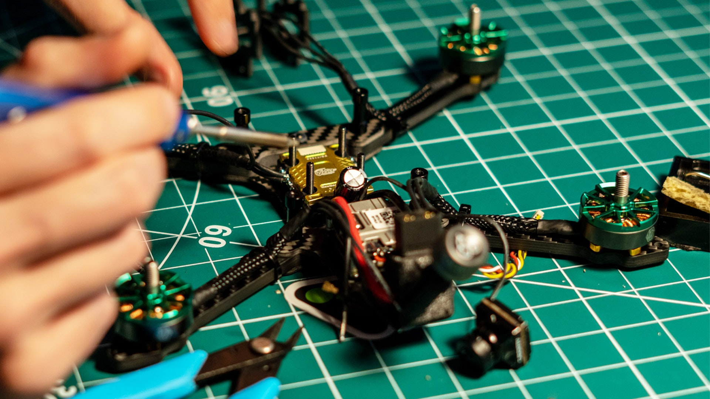
Building a drone!

Slide 16
Building a drone equipped with a LiDAR sensor to create a 3D map of a warehouse involves several steps. Here is a high-level overview of the process:
Choose the appropriate LiDAR sensor that fits your requirements and budget. The selection process should consider the scanning range, accuracy, weight, and compatibility with the drone platform.
Choose the appropriate drone platform. The selection process should consider the payload capacity, flight time, and compatibility with the LiDAR sensor.
Integrate the LiDAR sensor with the drone platform.
Configure the drone to fly in a specific pattern to collect LiDAR data. This may involve setting up a flight plan or manually flying the drone.
Process the LiDAR data using appropriate software to create a 3D point cloud of the warehouse. This may involve using software such as ROS, MATLAB, or Python.
Post-process the 3D point cloud to create a detailed 3D map of the warehouse. This may involve using software such as Autodesk Recap, CloudCompare, or Blender.
Analyze the 3D map to extract useful information such as object recognition, inventory management, or surveillance.

Slide 17
What is the format of LiDar data ? What does it look like ?
LiDAR data is typically stored in the form of point clouds, which are large sets of 3D points that represent the surface of objects in the environment that have been scanned by the LiDAR sensor. Each point in the point cloud is represented by its X, Y, and Z coordinates in a Cartesian coordinate system, which gives it a location in 3D space. In addition to the X, Y, and Z coordinates, each point may also have additional attributes such as reflectance values or intensity values, which provide information about the strength of the LiDAR signal reflected by the object at that location.
Point cloud data can be visualized using specialized software tools that allow the user to view and manipulate the data in 3D space, such as CloudCompare, LAStools, or ArcGIS Pro. The point cloud data can also be processed and analyzed using various algorithms to extract useful information, such as object detection, surface reconstruction, or terrain analysis.

Slide 18
How to extract info from LiDar data?
There are several software options that can be used to extract information and create a 3D map from LiDAR data. Here are a few popular ones:
CloudCompare: This is an open-source software that is widely used for point cloud processing and 3D modeling. It has a user-friendly interface and supports a wide range of LiDAR data formats.
QGIS: This is a free and open-source GIS software that can be used for LiDAR data analysis and visualization. It provides a range of plugins that can be used for LiDAR processing and 3D modeling.
ArcGIS Pro: This is a commercial GIS software developed by Esri that supports LiDAR data processing and 3D modeling. It provides a range of tools and workflows that can be used for LiDAR data analysis and visualization.
AutoCAD Civil 3D: This is a commercial software developed by Autodesk that can be used for LiDAR data processing and 3D modeling. It provides a range of tools for terrain modeling, volume calculations, and 3D visualization.
Global Mapper: This is a commercial software developed by Blue Marble Geographics that supports LiDAR data processing and 3D modeling. It provides a range of tools for terrain analysis, 3D modeling, and point cloud classification.

Slide 19
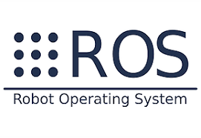
ROS (Robot Operating System) is a widely used open-source framework for robotics applications. It provides a collection of tools, libraries, and conventions to facilitate the development of complex robotics software. ROS has a powerful 3D visualization tool called RViz, which is used to visualize 3D point clouds generated from LiDAR data.
If you are using ROS for your LiDAR data processing, you will likely use it in the step of processing the LiDAR data to create a 3D point cloud. ROS provides many packages that can be used for LiDAR processing, such as the point_cloud library, which provides tools for point cloud filtering, segmentation, and registration.
In addition to LiDAR processing, ROS can also be used for robot control, simulation, and data visualization. If you are building a drone equipped with a LiDAR sensor, you may also use ROS for drone control and navigation.

Slide 20
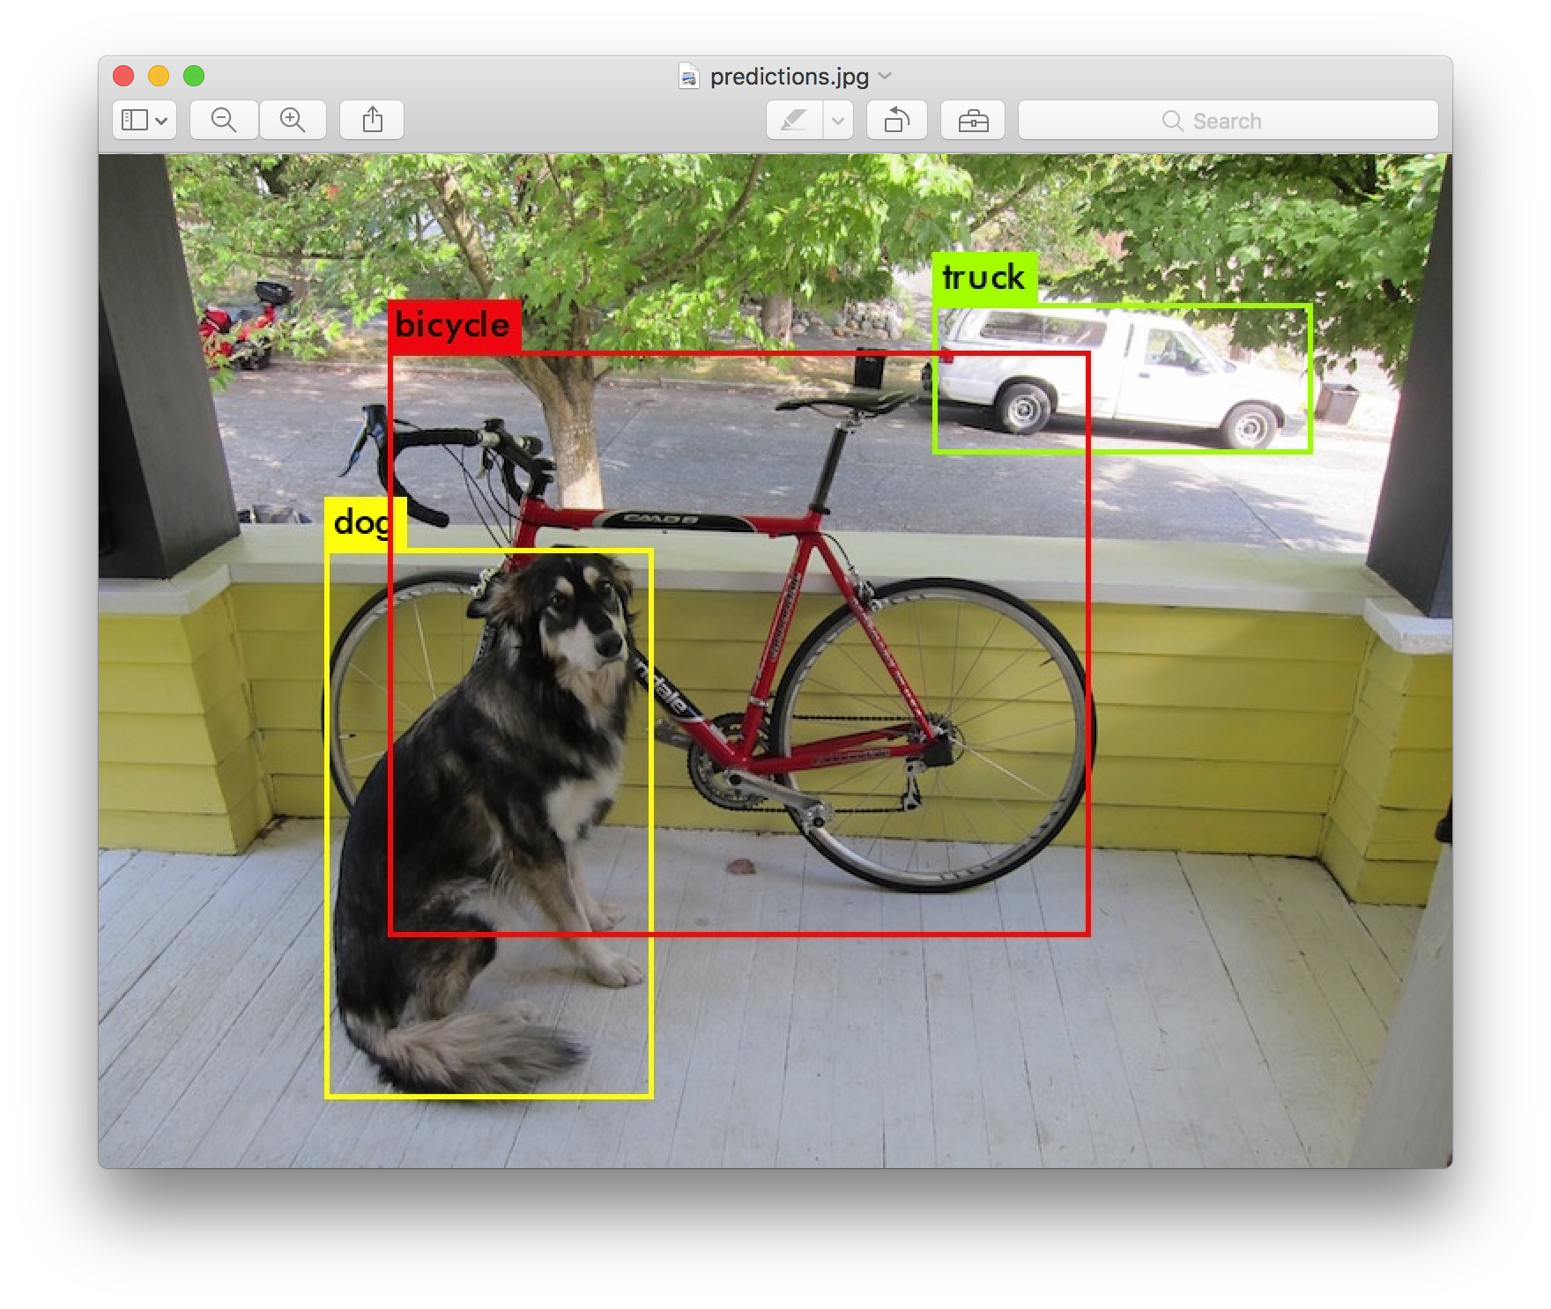
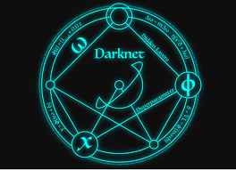
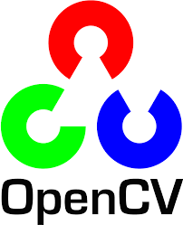
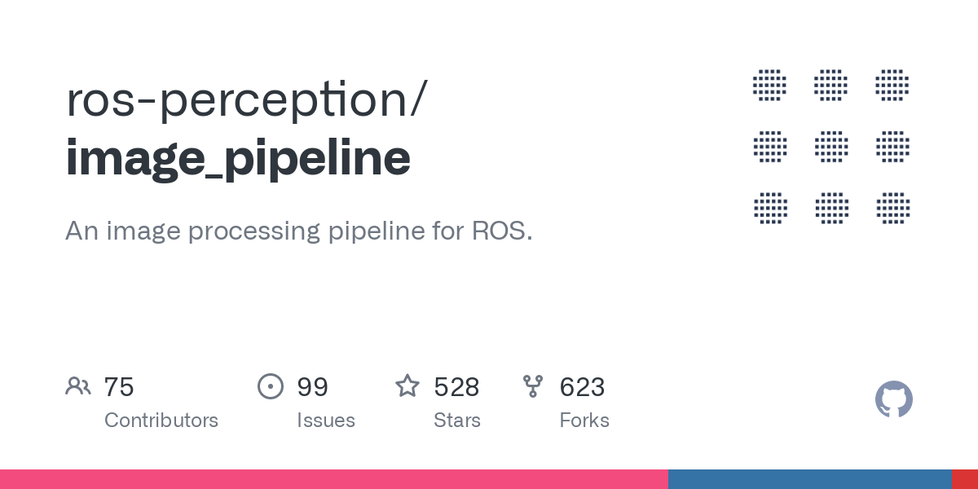
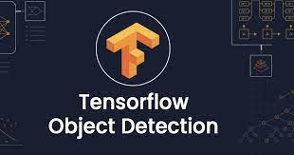
ROS Libraries for image/obstacle detection
https://pjreddie.com/darknet/yolo/

Slide 21
1. OpenCV: This is a powerful computer vision library that can be used to detect objects in images. You can use OpenCV to perform image processing techniques like filtering, edge detection, thresholding, and contour detection to detect small objects lying on the floor.
2. Darknet YOLO: This is a deep learning-based object detection library that can detect objects in real-time. You can use Darknet YOLO to detect small objects lying on the floor by training the model on your specific object class and testing it on images captured by your robot's camera.
3. TensorFlow Object Detection API: This is another deep learning-based object detection library that provides pre-trained models and tools to train custom object detection models. You can use TensorFlow Object Detection API to detect small objects lying on the floor by training the model on your specific object class and testing it on images captured by your robot's camera.
4. ROS Image Processing Pipeline (image_pipeline): This library provides a set of image processing nodes that can be used to perform various image processing tasks like color conversion, filtering, and image rectification. You can use these nodes to pre-process images captured by your robot's camera before passing them to your object detection algorithm.

Slide 22
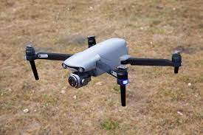
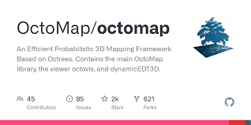
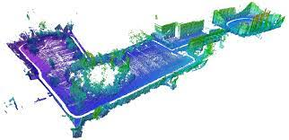
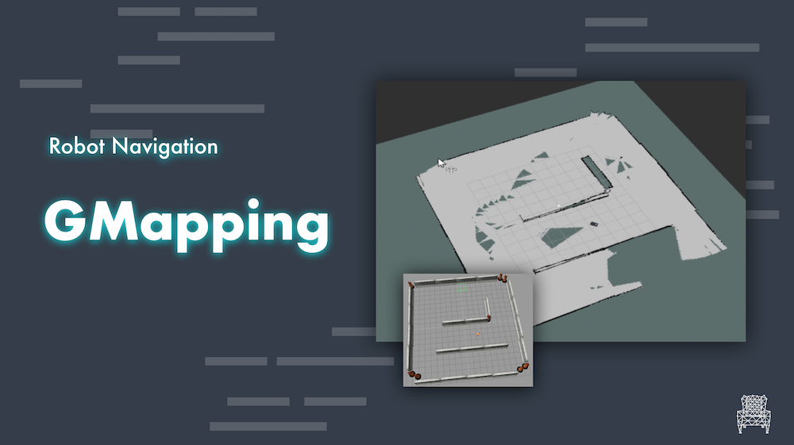
Libraries to use LiDAR Sensor

Slide 23
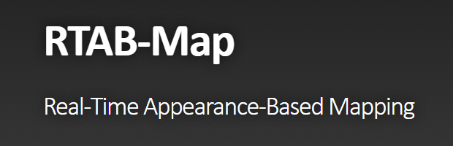
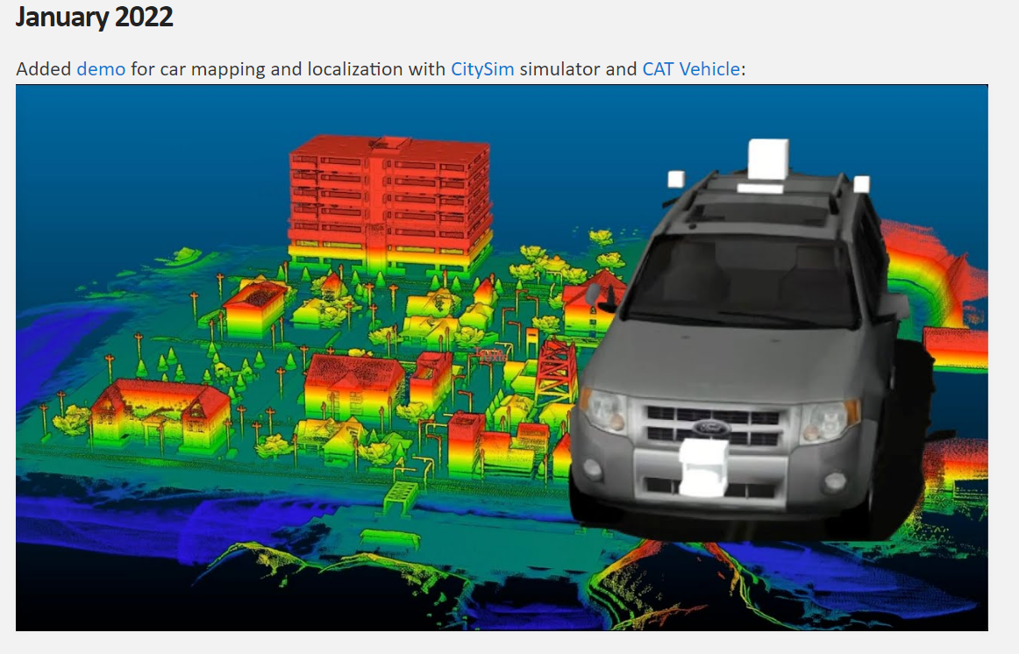
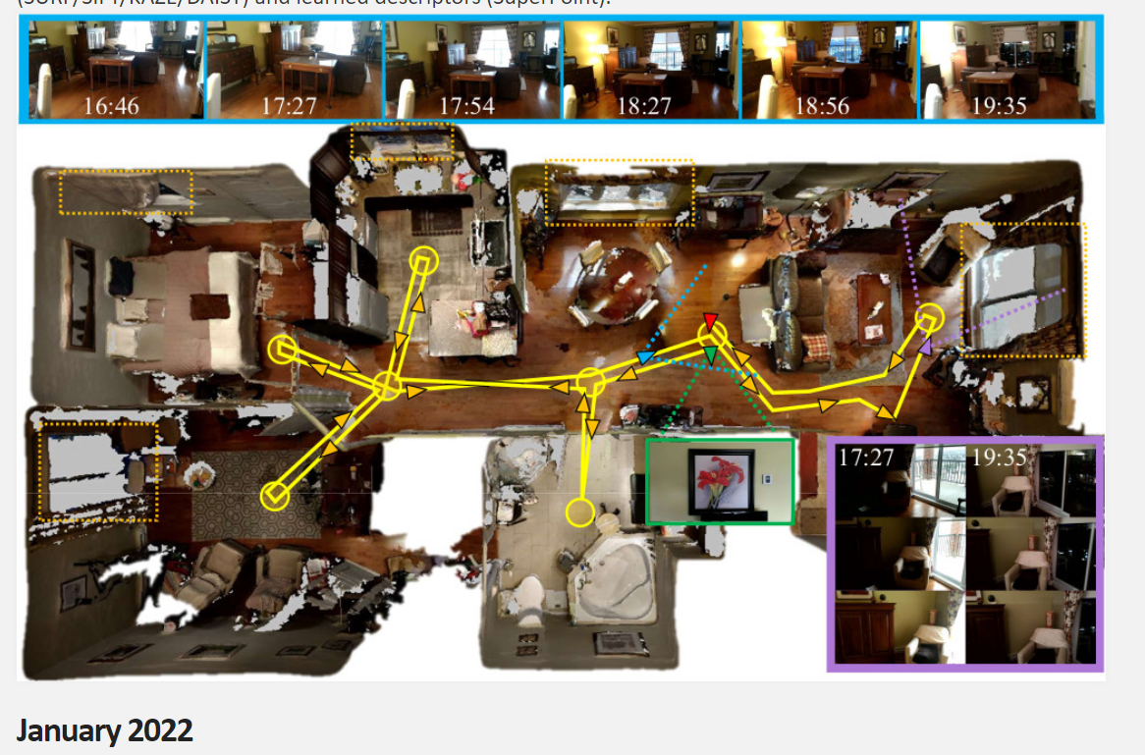
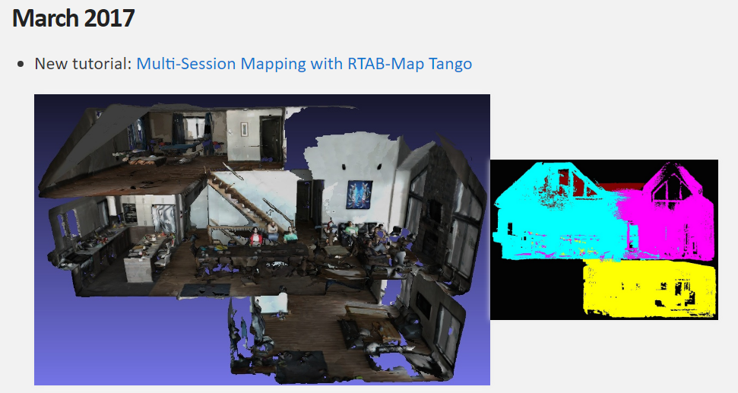
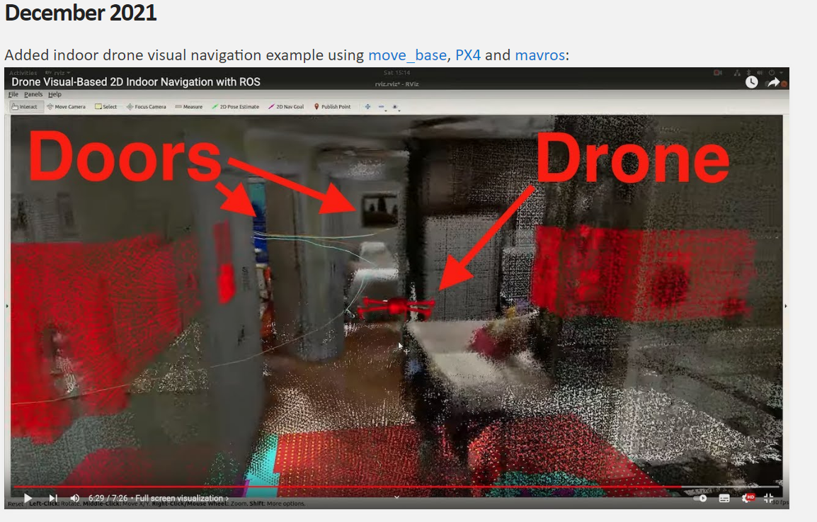
RTAB-Map: This package provides a 3D SLAM algorithm that uses RGB-D cameras, LIDAR sensors, or a combination of both to create a 3D map of the environment. It uses a graph-based approach to construct a map of the environment and can estimate the robot's pose and trajectory using sensor data. RTAB-Map is known for its robustness and is a good choice for robots that operate in challenging environments.

Slide 24
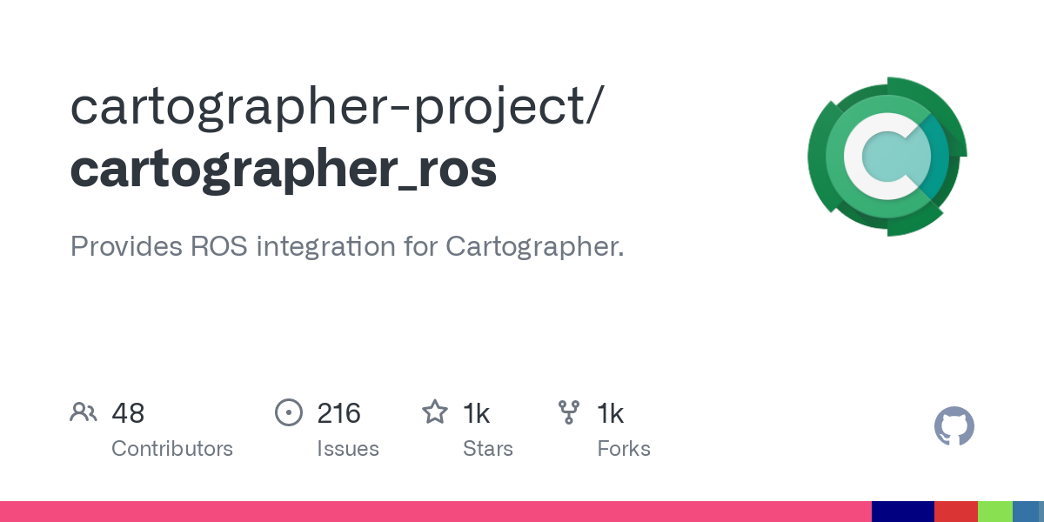
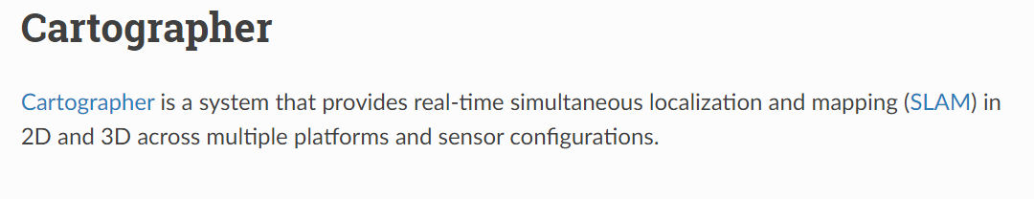

Slide 25
For 3d mapping
1.OctoMap: This package provides a 3D mapping algorithm that uses LIDAR sensors to create a 3D point cloud of the environment. The algorithm creates an occupancy grid map that represents the 3D space as a collection of 3D voxels. OctoMap is a popular choice for 3D mapping and has been extensively tested in ROS.
2.RTAB-Map: This package provides a 3D SLAM algorithm that uses RGB-D cameras, LIDAR sensors, or a combination of both to create a 3D map of the environment. It uses a graph-based approach to construct a map of the environment and can estimate the robot's pose and trajectory using sensor data. RTAB-Map is known for its robustness and is a good choice for robots that operate in challenging environments.
3.Cartographer: This package provides a 2D and 3D SLAM algorithm that can use LIDAR sensors, as well as other sensors such as cameras and IMUs. It uses a global optimization approach to construct a map of the environment and can estimate the robot's pose and trajectory using sensor data. Cartographer is a relatively new package in ROS and is known for its accuracy and scalability.

Slide 26
For 2d mapping
1. gmapping: This package provides a 2D SLAM algorithm for mapping and navigation using LIDAR sensors. It uses a grid-based approach to construct a map of the environment and can estimate the robot's pose and trajectory using sensor data. Gmapping is a popular choice for mobile robots and has been extensively tested in ROS.
2. hector_slam: This package provides a 2D SLAM algorithm that uses LIDAR sensors and is based on scan matching. It uses a graph-based approach to construct a map of the environment and can estimate the robot's pose and trajectory using sensor data. Hector SLAM is known for its robustness and is a good choice for robots that operate in challenging environments.
3. cartographer: This package provides a 2D and 3D SLAM algorithm that can use LIDAR sensors, as well as other sensors such as cameras and IMUs. It uses a global optimization approach to construct a map of the environment and can estimate the robot's pose and trajectory using sensor data. Cartographer is a relatively new package in ROS and is known for its accuracy and scalability.
4. navigation: This package provides a collection of tools and algorithms for robot navigation, including localization, path planning, and obstacle avoidance. It can be used with LIDAR sensors to create a map of the environment and to navigate the robot autonomously. Navigation is a comprehensive package that can be used for a wide range of robotic applications.

Slide 27
So we can use both LIDAR and camera sensors to create a more comprehensive map of your environment. This approach is often referred to as "sensor fusion" and is commonly used in robotics and autonomous vehicles.
By combining the data from multiple sensors, you can obtain a more complete and accurate representation of the environment. LIDAR sensors provide accurate range data and can be used to create a high-resolution 3D point cloud of the environment, while cameras can provide color and texture information that can be used to identify and track objects in the environment.
There are several ROS packages that support sensor fusion, including the Kalman filter and the particle filter. These filters can be used to combine the data from multiple sensors and estimate the position and orientation of the robot in the environment.
Overall, using both LIDAR and camera sensors can provide a more comprehensive and accurate map of the environment and can improve the performance of your robotic system.

